Slide 1
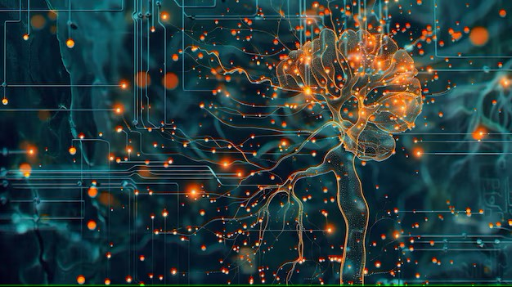



Week-6 (Discussion)
4th Mar, 2025
Deep Learning
Prof. Sudarshan Iyenger
Professor and Head of the Department
Department of Computer Science and Engineering
IIT Ropar
Ayan Paul
PMRF Research Scholar
IIT Kharagpur

Slide 2
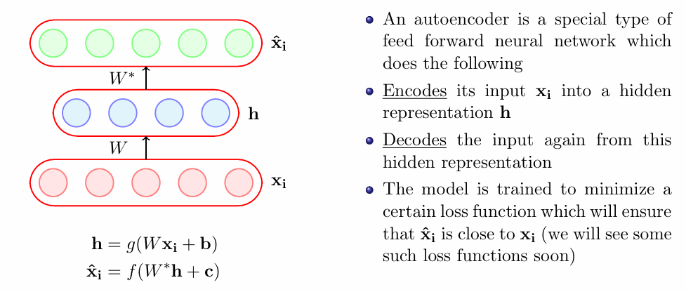
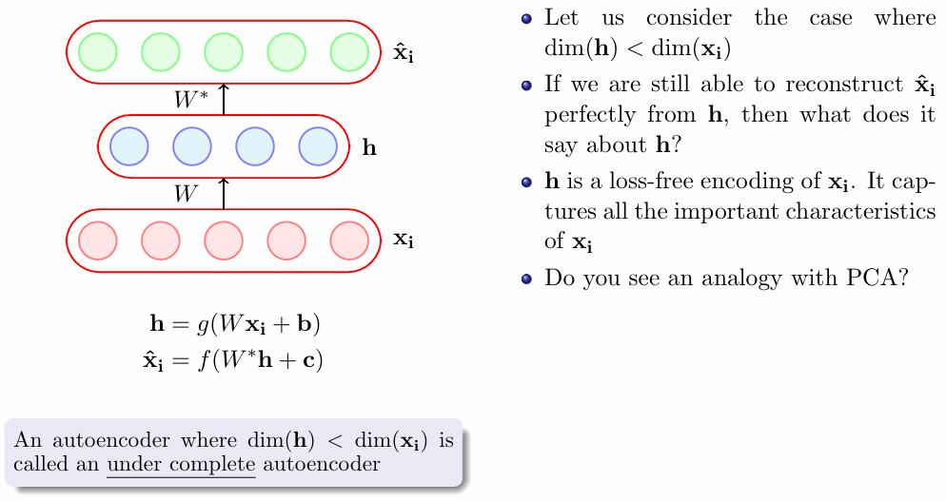
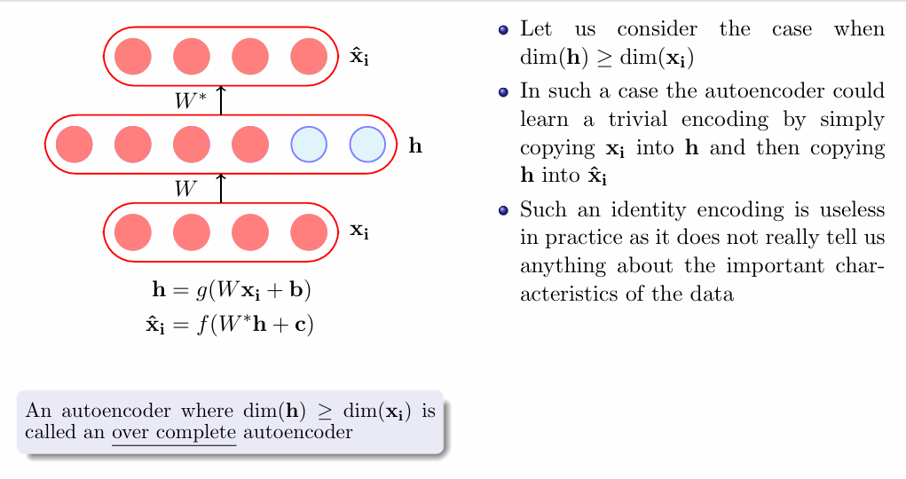
Autoencoders
Under Complete
Autoencoder
Over Complete
Autoencoder

Slide 3
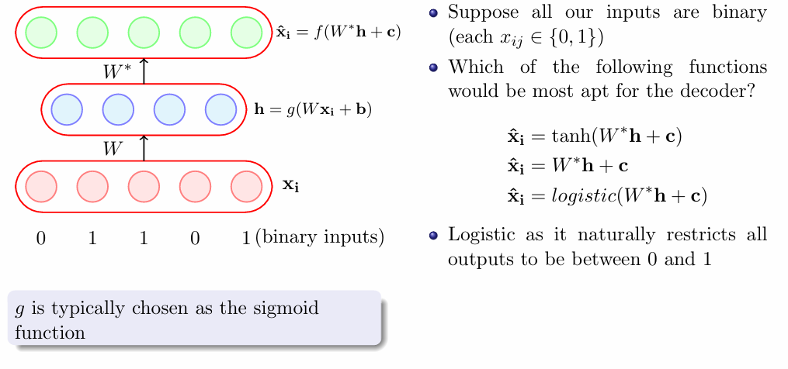
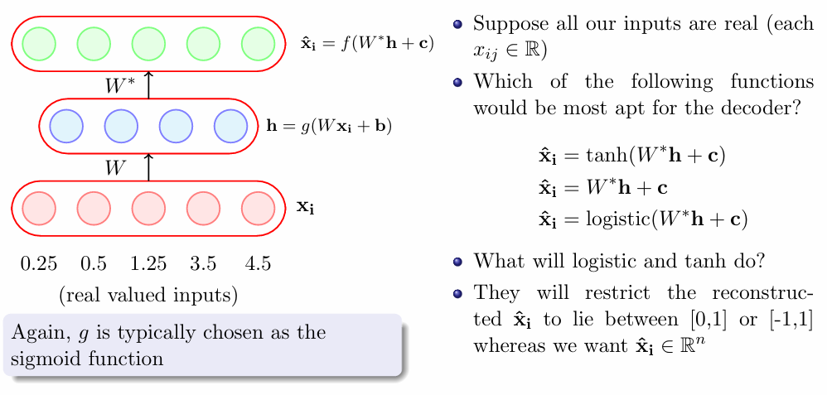
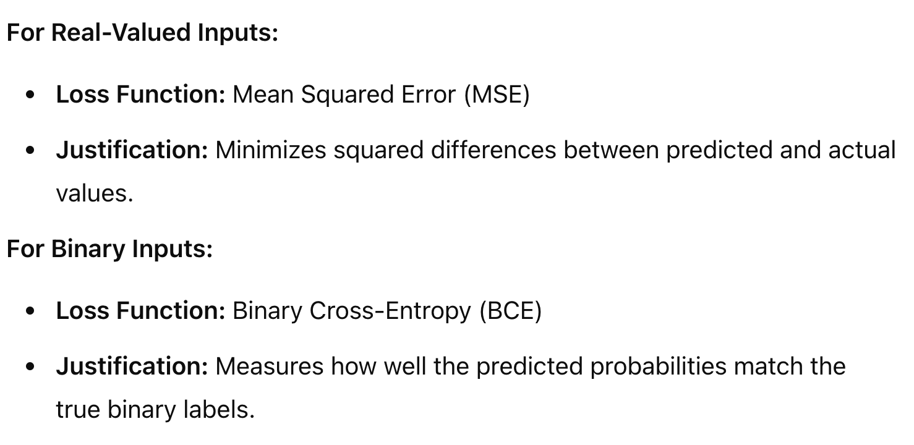
Choice of activation function
f is typically chosen to be logistic
Reason: Maps output between [0,1], suitable for binary reconstruction.
f is typically chosen to be linear
Reason: Preserves continuous numerical values without constraint
Choice of Loss Function

Slide 4
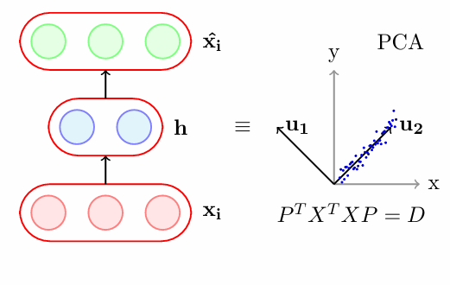
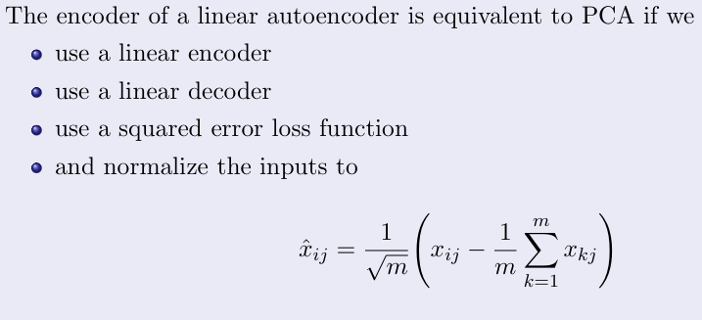
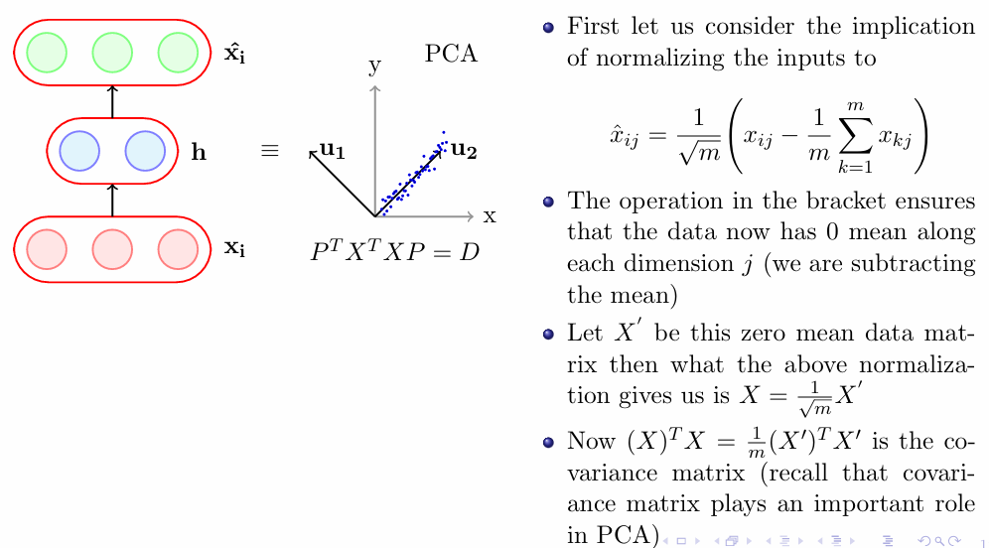
Link between Autoencoder and PCA

Slide 5
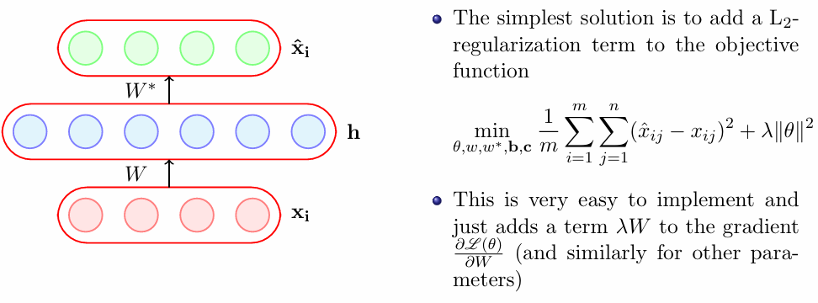
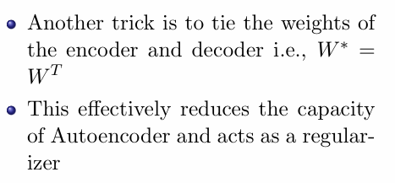
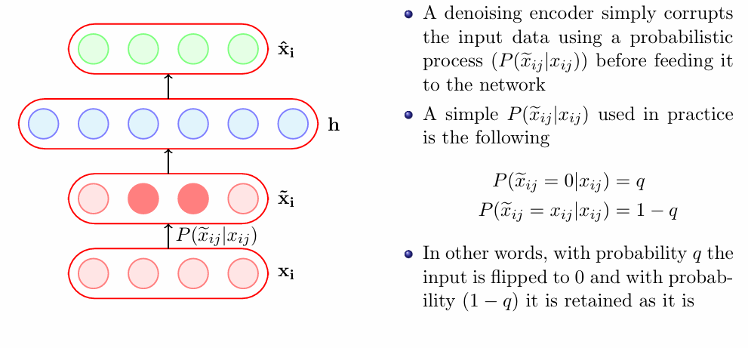
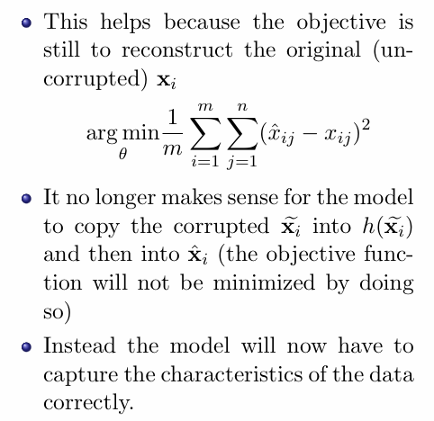
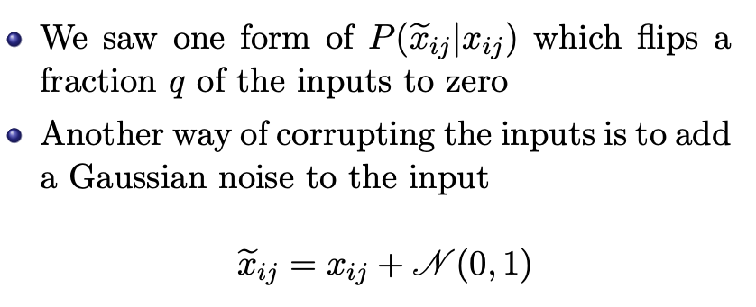
Regularization in Autoencoders
Denoising Autoencoders

Slide 6
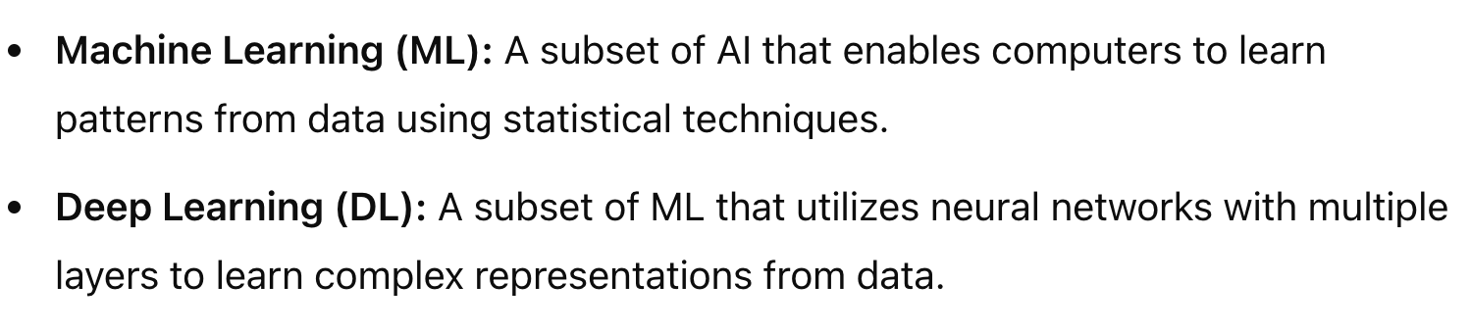
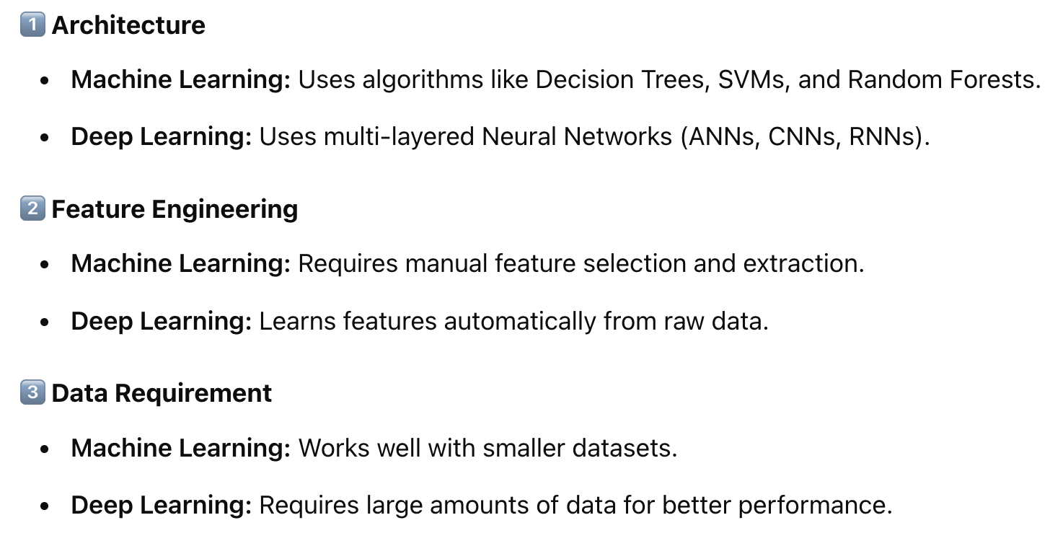
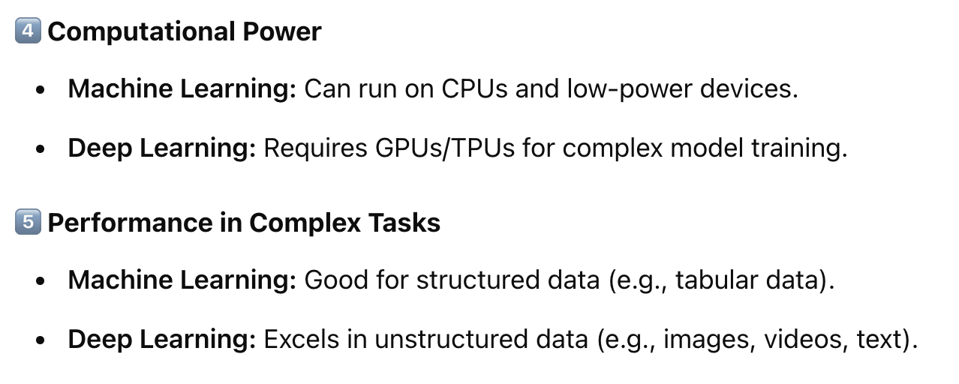
Difference between Machine Learning and Deep Learning
Key Differences

Slide 7
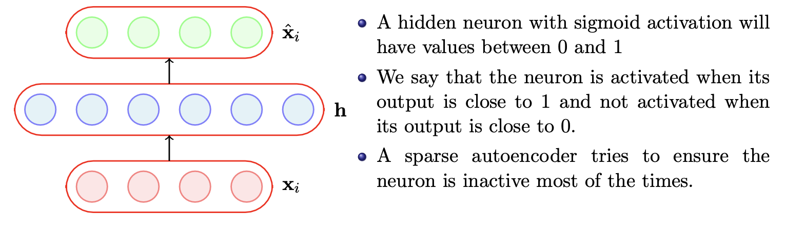
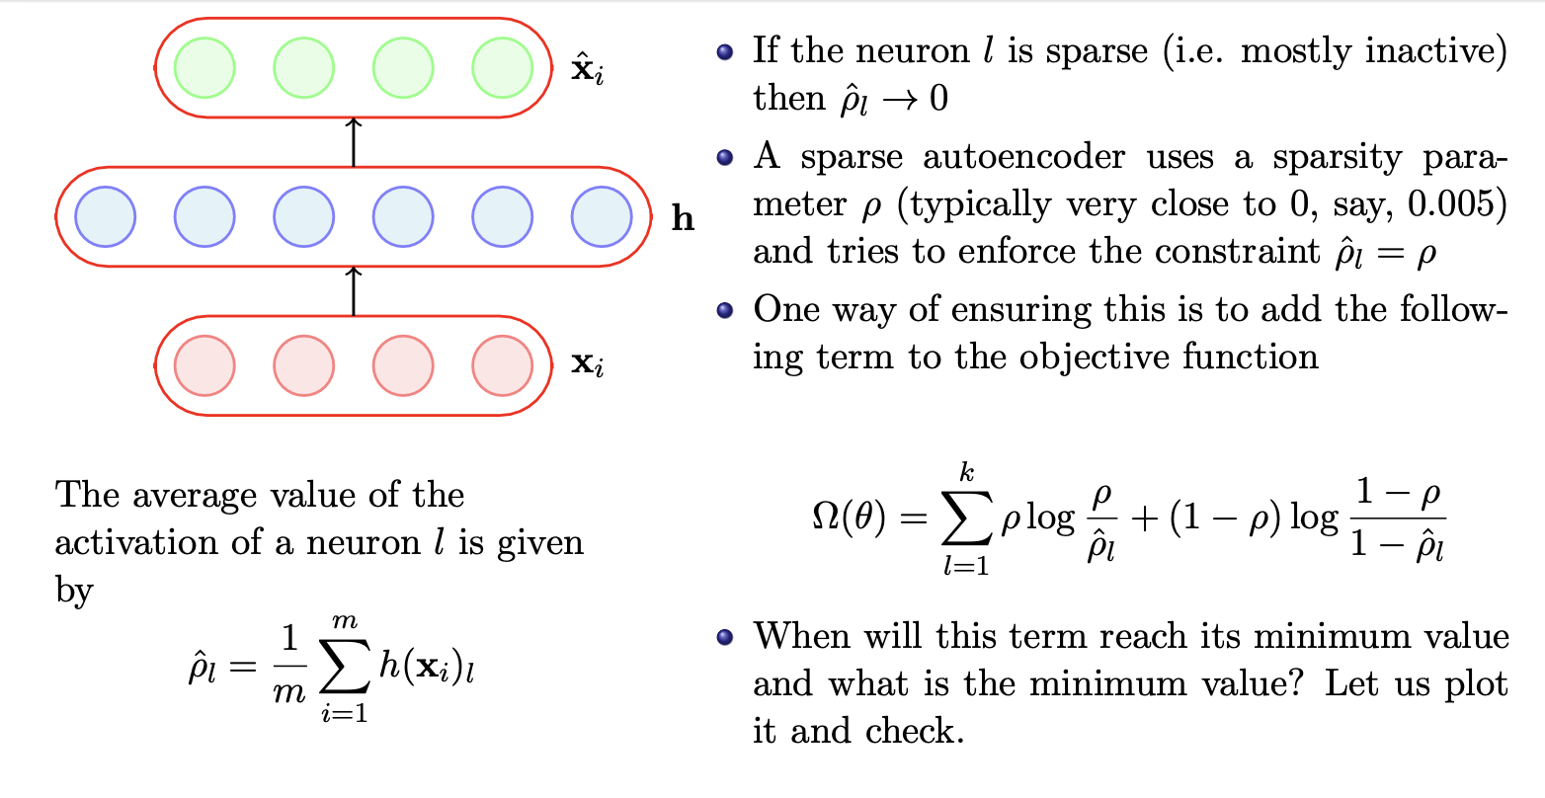
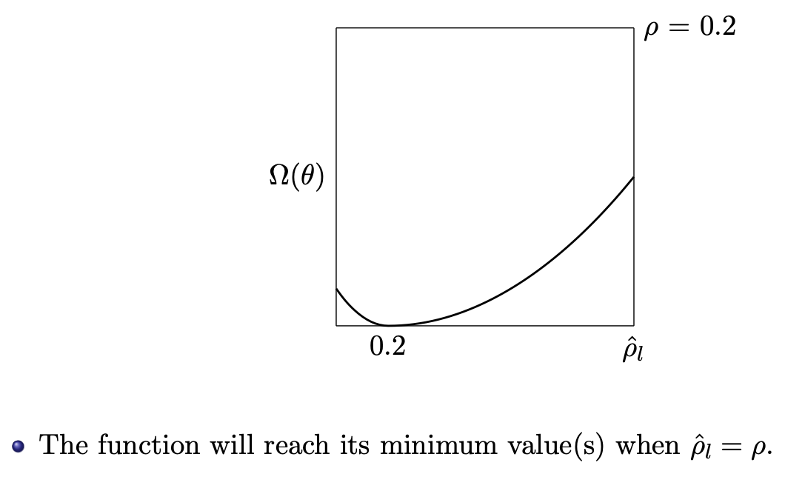
Sparse Autoencoders

Slide 8
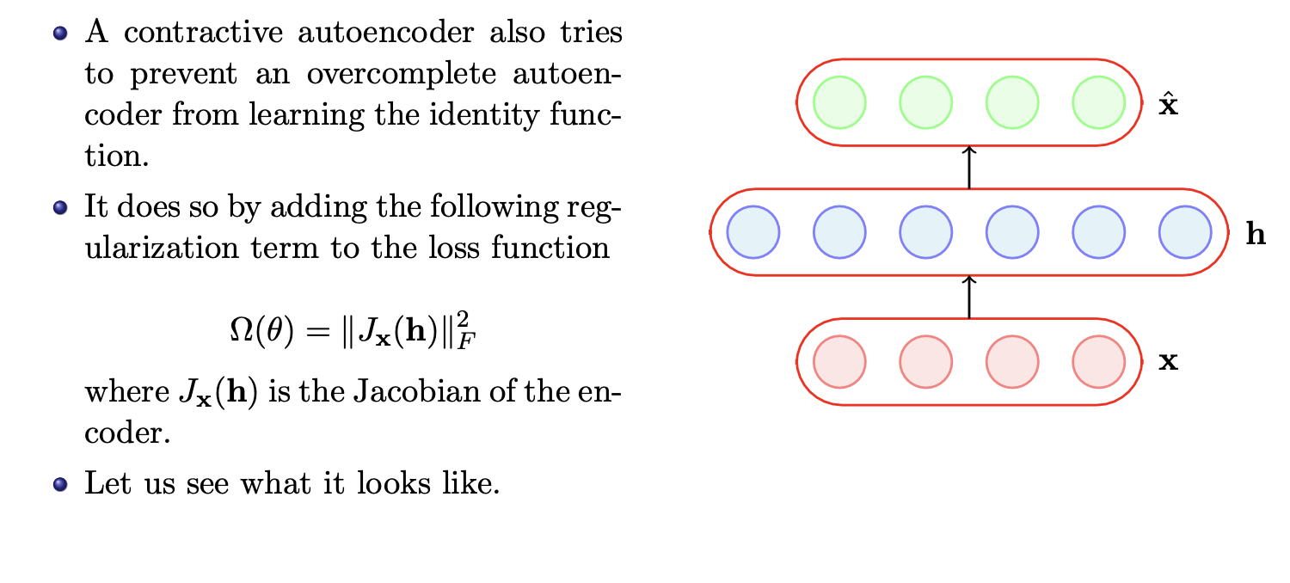
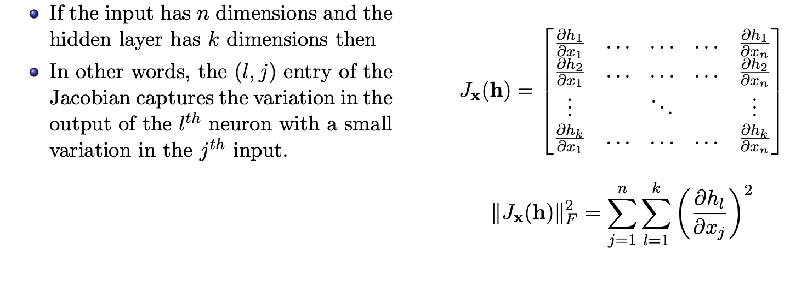
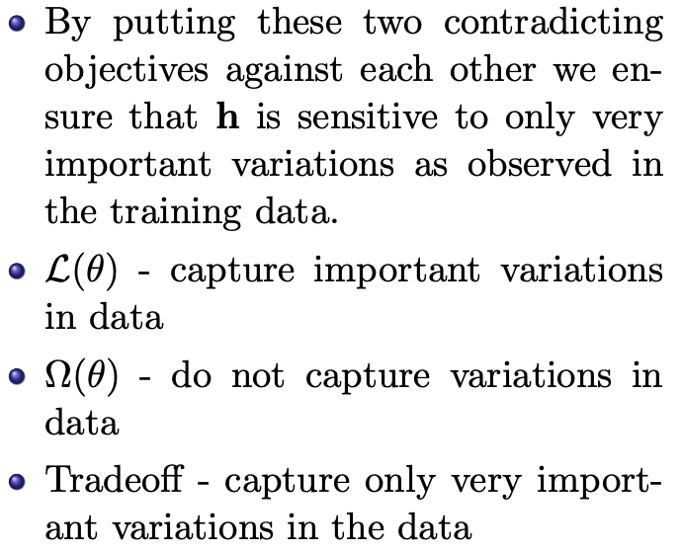
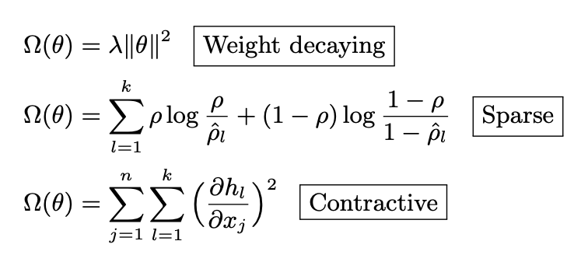
Contractive Autoencoders
Summary of Regularization

Slide 9
Topics on which Week 6 Assignment Questions are based
Autoencoders
Under Complete and Over Complete Autoencoders
Link between Autoencoders and PCA
Denoising Autoencoders
Sparse Autoencoders
Contractive Autoencoders

Slide 10
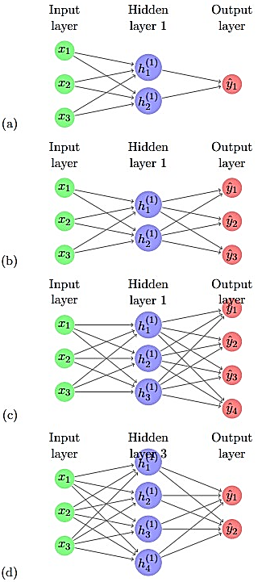
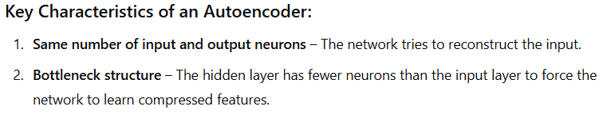
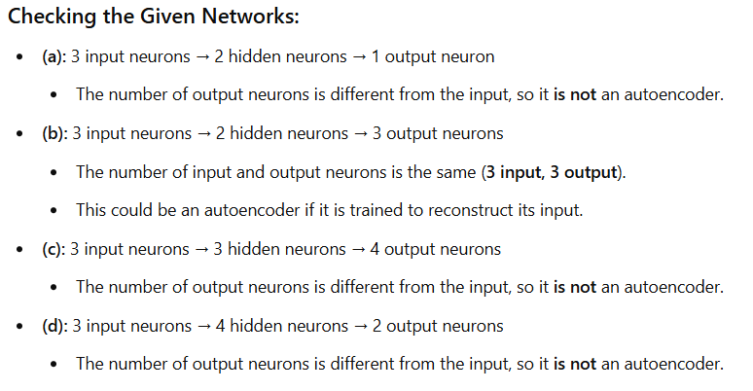
QUESTION 1
Which of the following networks represents an autoencoder?
SOLUTION 1
CORRECT ANSWER 1
b)

Slide 11
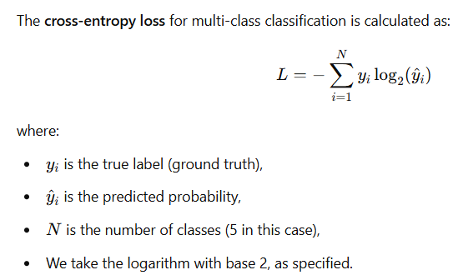
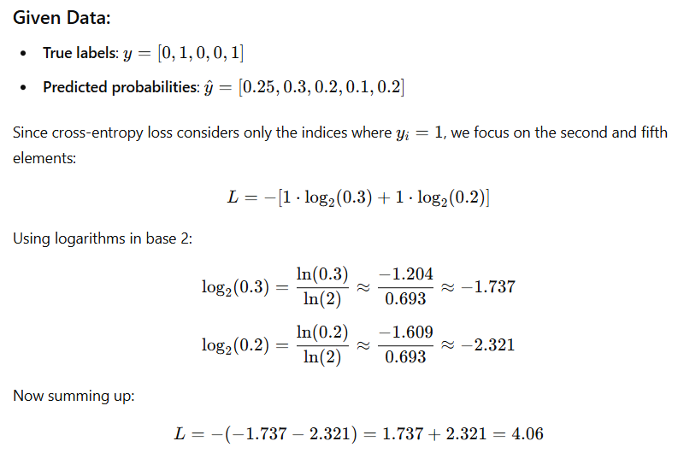
QUESTION 2
Suppose we build a neural network for a 5-class classification task. Suppose for a single training example, the true label is [0 1 0 0 1] while the predictions by the neural network are [0.25 0.3 0.2 0.1 0.2]. What would be the value of cross-entropy loss for this example? (Answer up to two decimal places, Use base 2 for log-related calculations)
SOLUTION 2
CORRECT ANSWER 2
(Type: Range) 4.0,4.1

Slide 12
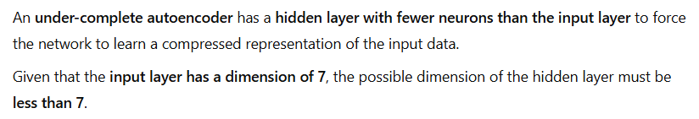
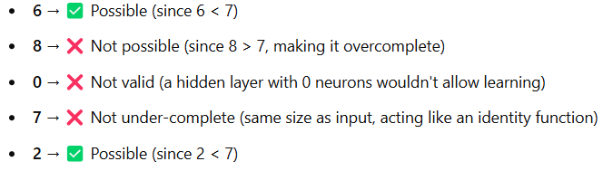
QUESTION 3
If an under-complete autoencoder has an input layer with a dimension of 7, what could be the possible dimension of the hidden layer?
6
8
0
7
2
SOLUTION 3
CORRECT ANSWER 3
a), e)

Slide 13
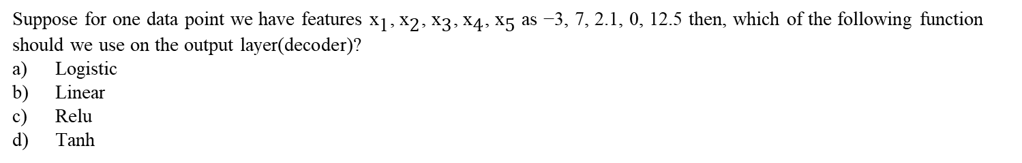
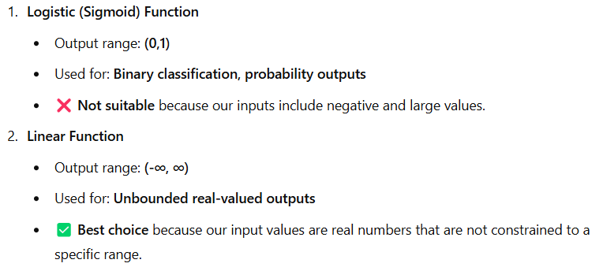

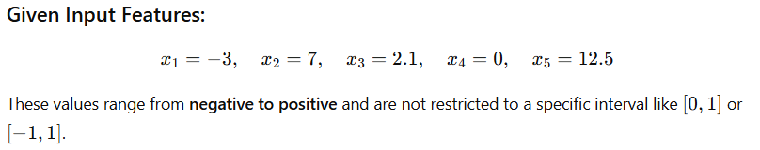
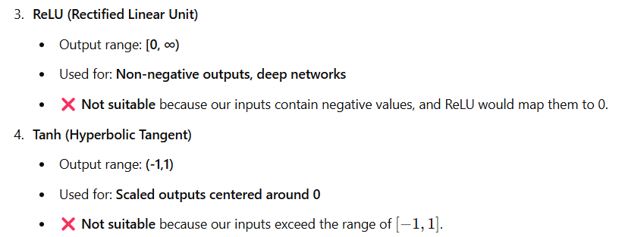
QUESTION 4
SOLUTION 4
CORRECT ANSWER 4
b)

Slide 14
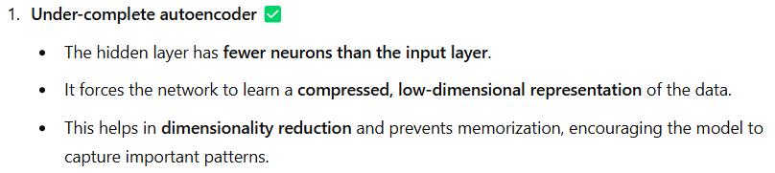
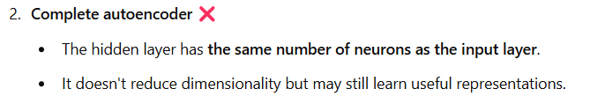
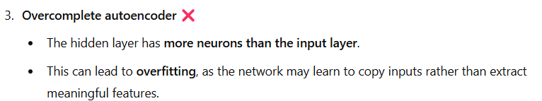
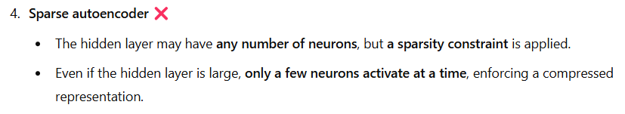
QUESTION 5
What type of autoencoder is it when the hidden layer’s dimensionality is less than that of the input layer?
Under-complete autoencoder
Complete autoencoder
Overcomplete autoencoder
Sparse autoencoder
SOLUTION 5
CORRECT ANSWER 5
a)

Slide 15
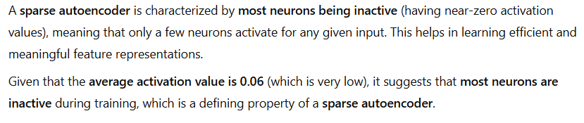
QUESTION 6
We are given an autoencoder A. The average activation value of neurons in this network is 0.06. The given autoencoder is:
Contractive autoencoder
Overcomplete neural network
Sparse autoencoder
Denoising autoencoder
SOLUTION 6
CORRECT ANSWER 6
c)

Slide 16
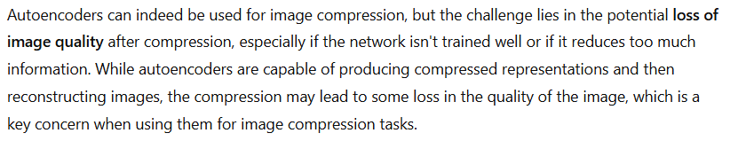
QUESTION 7
Which of the following problems prevents us from using autoencoders for the task of Image compression?
Images are not allowed as input to autoencoders
Difficulty in training deep neural networks
Loss of image quality due to compression
Auto encoders are not capable of producing image output
SOLUTION 7
CORRECT ANSWER 7
c)

Slide 17
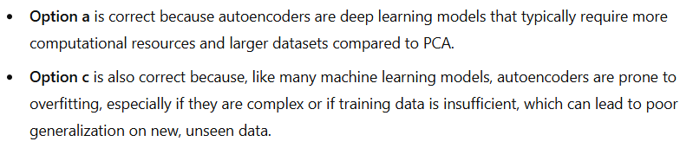
QUESTION 8
Which of the following is a potential disadvantage of using autoencoders for dimensionality reduction over PCA?
Autoencoders are computationally expensive and may require more training data than PCA.
Autoencoders are bad at capturing complex relationships in data
Autoencoders may overfit the training data and generalize poorly to new data.
Autoencoders are unable to handle linear relationships between data.
SOLUTION 8
CORRECT ANSWER 8
a), c)

Slide 18
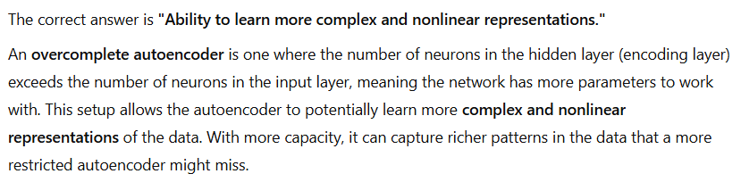
QUESTION 9
Which of the following is a potential advantage of using an overcomplete autoencoder?
Reduction of the risk of overfitting
Ability to learn more complex and nonlinear representations
Faster training time
To compress the input data
SOLUTION 9
CORRECT ANSWER 9
b)

Slide 19
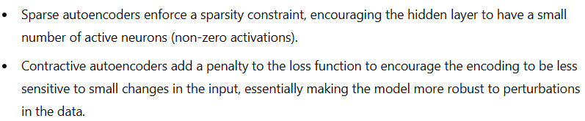
QUESTION 10
Which of the following is a key difference between sparse and contractive autoencoders?
Sparse autoencoders aim to reduce the number of non-zero activations in the hidden layer, while contractive autoencoders aim to make the encoder’s output less sensitive to small changes in input data.
Sparse autoencoders penalize large weights in the network, while contractive autoencoders focus on reconstructing the data with less distortion.
Sparse autoencoders use a linear activation function in the hidden layer, while contractive autoencoders use a nonlinear activation function.
Sparse autoencoders require a large amount of labeled data, whereas contractive autoencoders can operate effectively with smaller labeled datasets.
SOLUTION 10
CORRECT ANSWER 10
a)

